Slide 1

Bacchus Winery Database Design
Group 3: Javonta Young, Mason Buller, Margaret Shimerdla, Julio Cruz Romero

Slide 2
Group Introduction
My name is Maggie. I hope to be a software developer someday and would love to be a web developer. I want to help design web pages.
My name is Javonta aka Von or Vonta. I wish to get my master's in software development and learn multiple languages while I am at it.
My name is Mason. I want to get my master’s in software development from Georgia Tech and primarily focus on Java.
My name is Julio and I work for Disney as a front-line cast member. Eventually I would like to work as Software Developer for the company and help create software to help Guests with their needs, understanding it from the front-line point of view.

Slide 3
Bacchus Winery Case Study Summary
The company was inherited by two sons who wanted to keep all current personnel. They have managers for finances and payroll, marketing, and production. They also have a marketing assistant and twenty production line workers.
They grow grapes to make Merlot, Cabernet, Chablis, and Chardonnay.
They receive bottling supplies from three different suppliers and have two people in charge of keeping track of supply deliveries and inventory.
They want a more efficient way to keep track of ordering supplies, track shipments, and allow their distributors to order online.

Slide 4
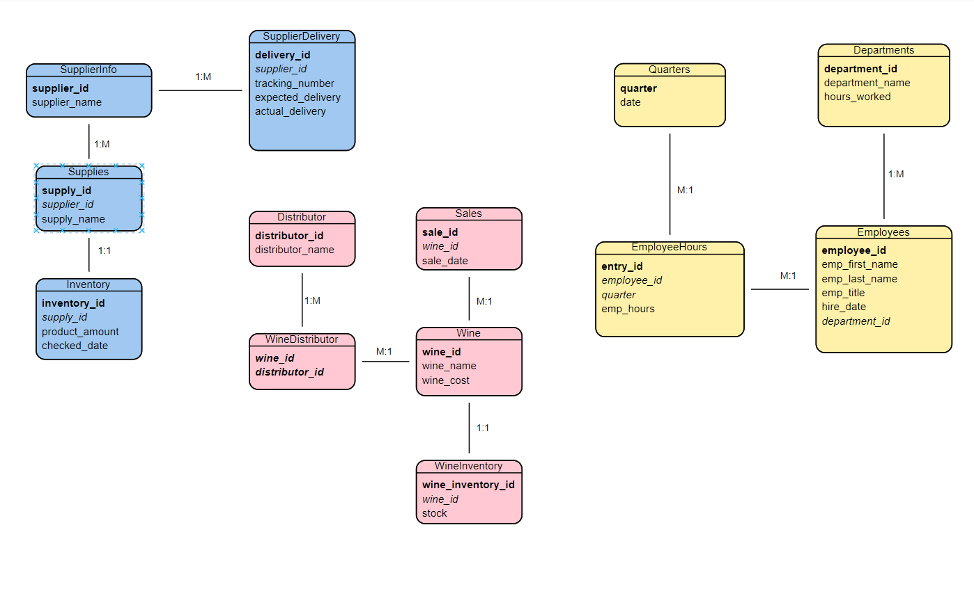
Entity Relationship Design

Slide 5
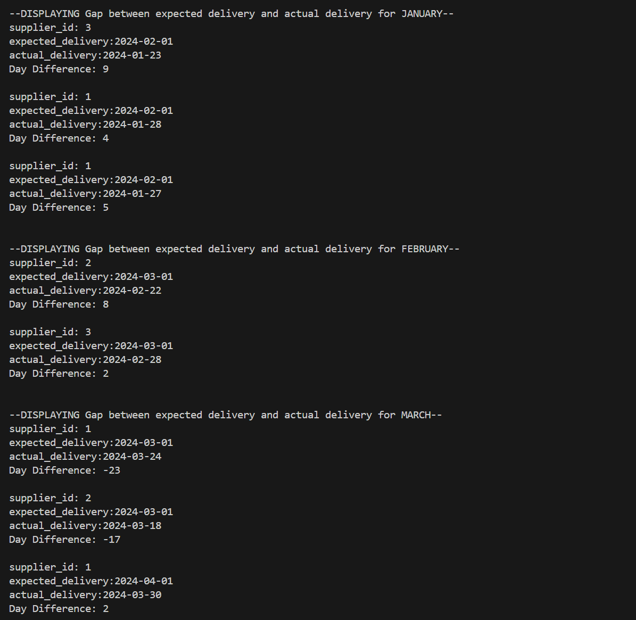
Report 1
Are all suppliers delivering on time?
Is there a large gap between expected delivery and actual delivery?
A month-by-month report should show problem areas.

Slide 6
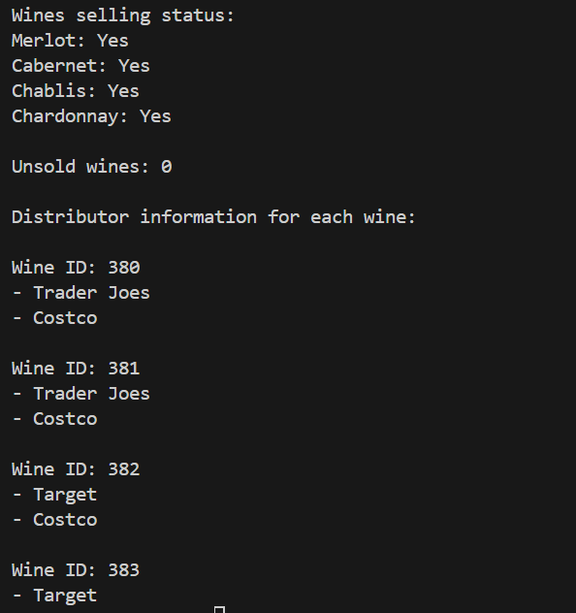
Report 2
The wine distribution, are all wines selling as they thought?
Is one wine not selling?
Which distributor carries which wine?

Slide 7
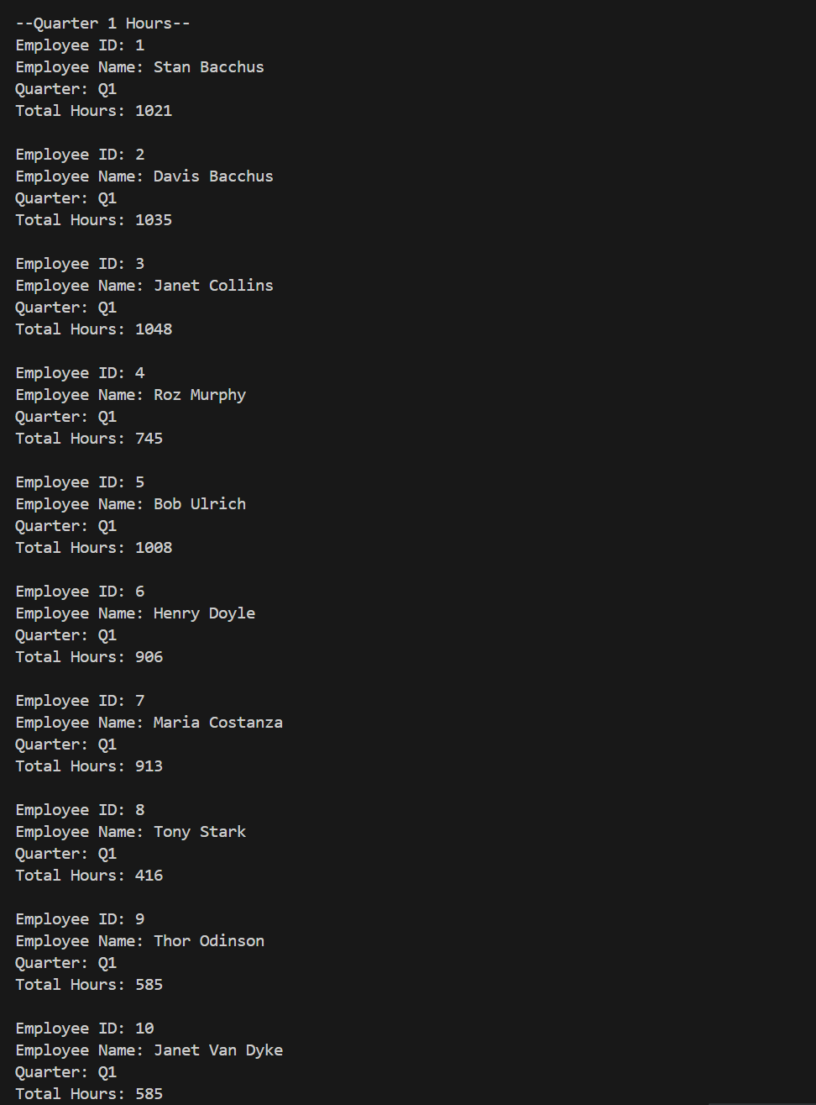
Report 3
During the last 4 quarters, How many hours did each employee work?

Slide 8
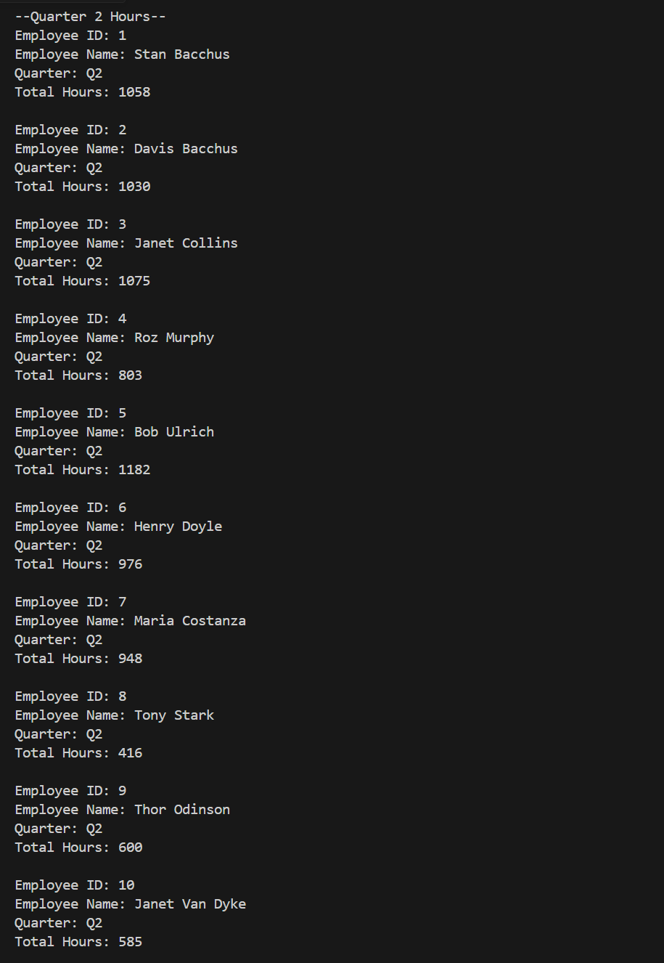
Report 3 (cont’d)
Quarter 2 Results

Slide 9
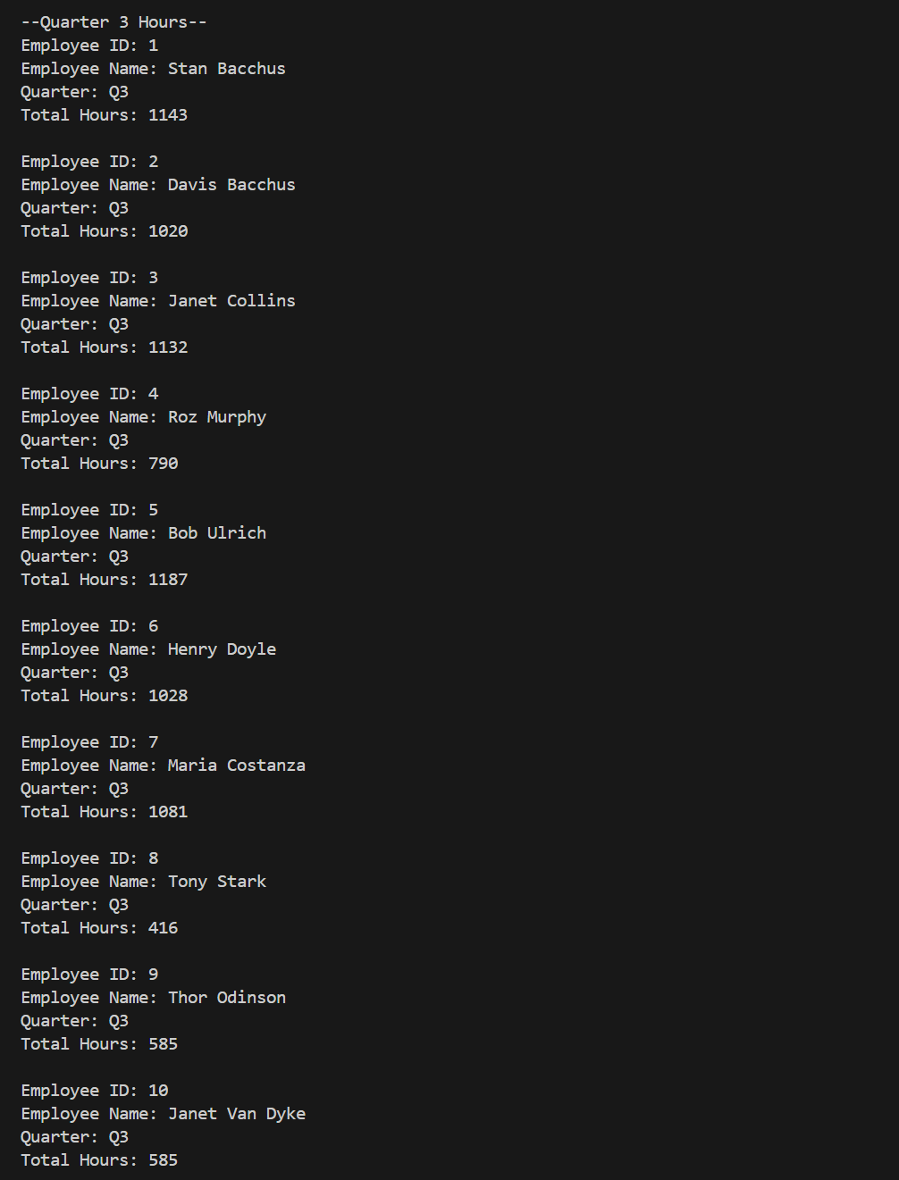
Report 3 (cont’d)
Quarter 3 Results

Slide 10
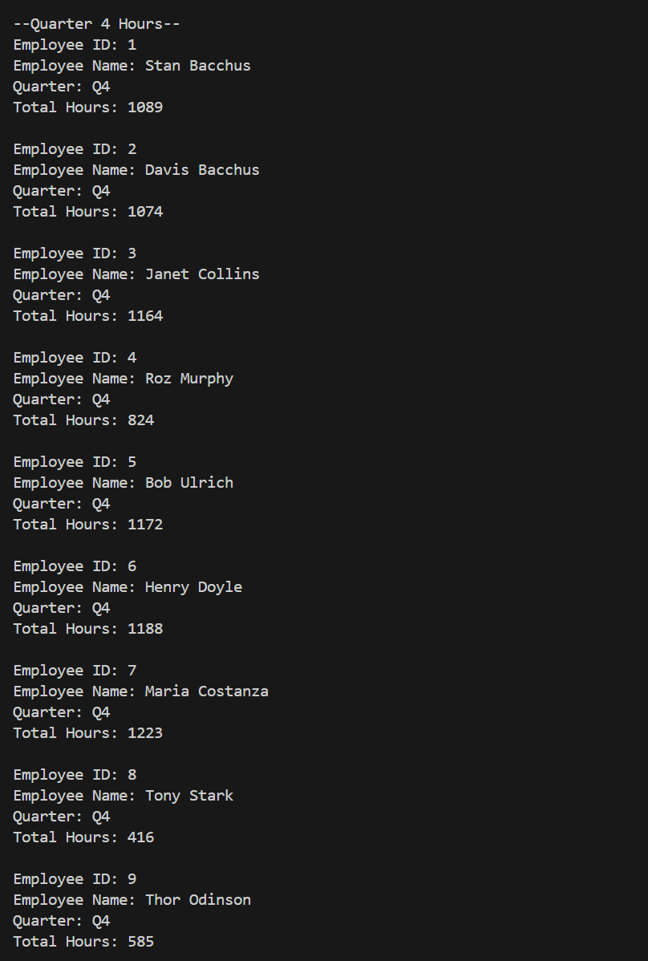
Report 3 (cont’d)
Quarter 4 Results

Slide 11
Case Study Assumptions
Online ordering is in a different database
Everything is ordered online by retailers ( i.e. Costco, Target, etc..)
Chablis does not sell much because it is pricey
Head of department workers are on call
Some workers hours were different in Quarters because of appointments and personal matters
Some workers did overtime for extra money

